Slide 1
Community Engagement
Shelley Nicholson, Ph.D (Director)
Rose Calder, M. Ed (Coordinator)
Follow us on:
InvolveMount
Twitter: bc_mwcc
Instagram: bc_mwcc
FB: brewercentermwcc
Notes:
Welcome!
Follow us on:
InvolveMount
Twitter: bc_mwcc
Instagram: bc_mwcc
FB: brewercentermwcc

Slide 2
Agenda
Community Engagement Opportunities
DocHub/Give Pulse
Next Steps

Slide 3
Community Engagement Opportunities
Why participate?
Give back to community
Learn about social issues populations face
Gain experience and network
Explore your passions!

Slide 4
Community Engagement Opportunities
What do you like to do?
What are your hobbies/passions?
What do you see yourself doing as a career?
What engagement work have you done before?
What are you interested in learning?

Slide 5
Community Engagement Opportunities
Connection to Social Issue
Think about a social issue your community faces. (i.e. poverty, healthcare, etc.)
What social issue comes to mind or one that you are passionate about?

Slide 6
Community Engagement Opportunities
Connection to Passions
Think about the passion/hobby you just thought of and the social issue your community faces.
Is there a way to connect your passion to the social issue your community is facing?
Is there an organization that comes to mind that might be of need?
Have you volunteered before?
Is there somewhere you would like to volunteer?

Slide 7
Community Engagement Opportunities
Possible Opportunities Available
Trail Clean Up
DCF Backpacks
Family Resource Room
Senior Center - Templeton

Slide 8
Questions?
What questions, comments, or concerns do you have?

Slide 9
DocHub Process

Slide 10
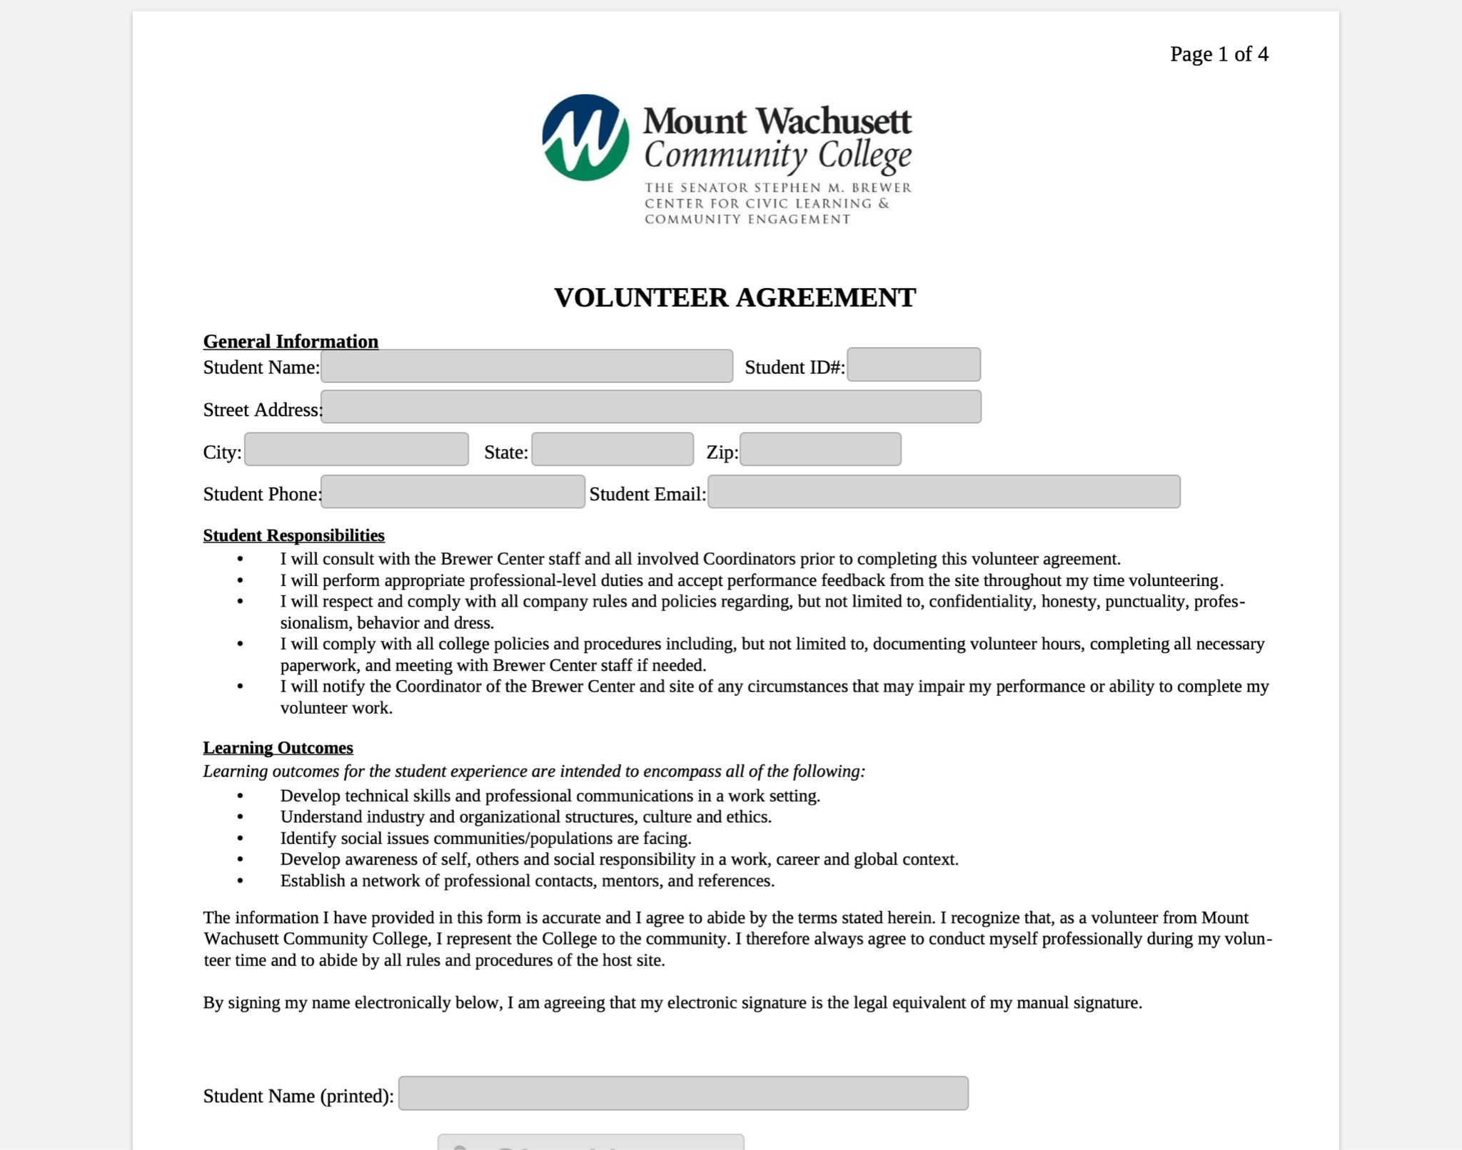
DocHub Form
Notes:
DocHub Forms that MUST be completed before starting your volunteering.
Liability form – highlighted with the yellow box
you complete and sign – 4 pages
*All forms once complete are auto sent to me and a copy will be sent to your email.

Slide 11
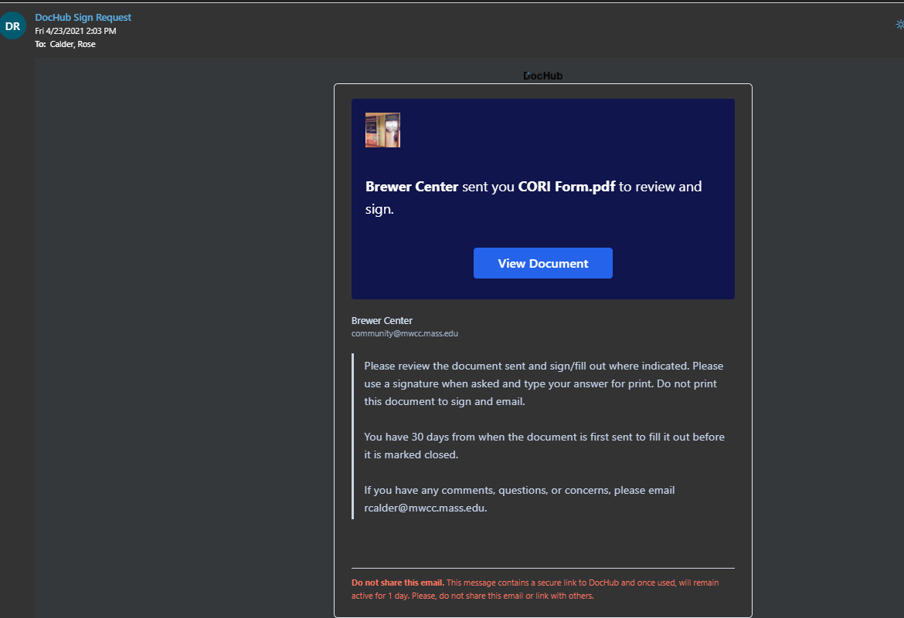
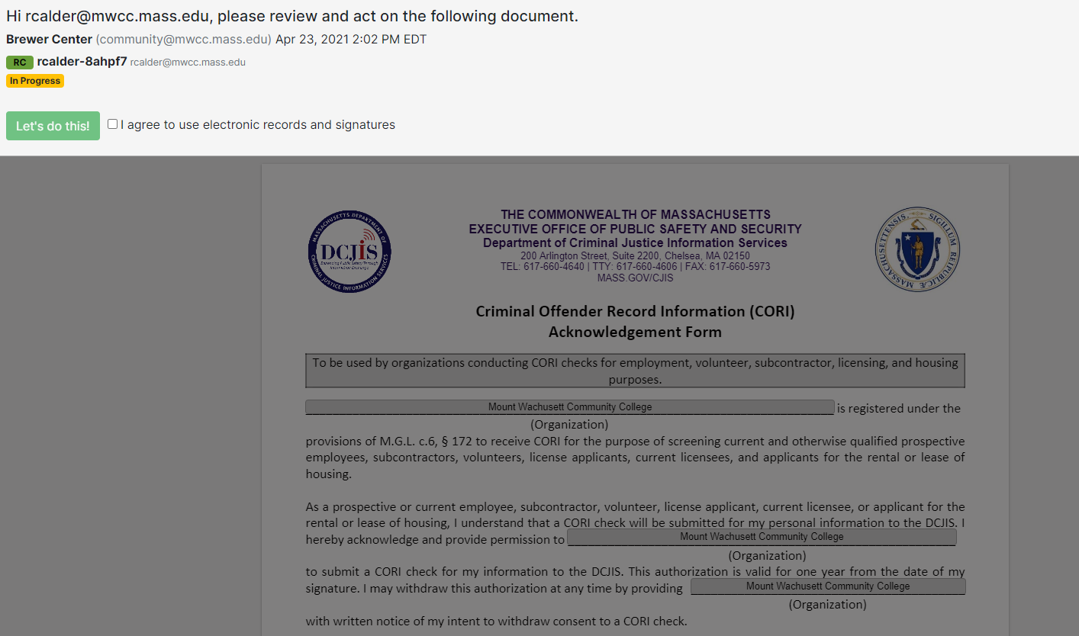
DocHub – Email Invite
Notes:
DocHub - online software to sign documents – no need to print!
You will receive an email to your MWCC email from DocHub generated by me – check your spam folder
Note!! Be sure you have the time to complete the form once you open it. Once you save and send at the end, you will not be able to re-access it.
(First Photo on the left) - Once you receive that email, this is what it will look like. Click on “View Document” in order to open the form.
(Photo on the right) – after clicking “View Document” from the email invite, you will see the disclaimer.
Check the “I agree to use electronic records and signatures” and then the “Let’s do this!” green button to begin.

Slide 12
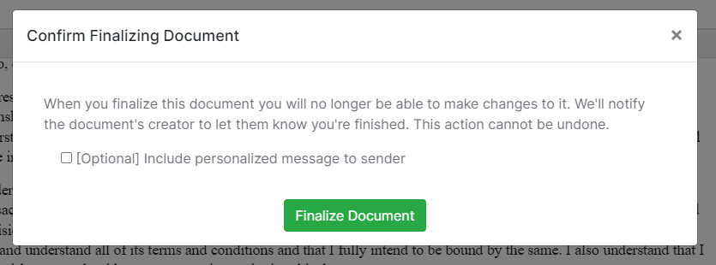
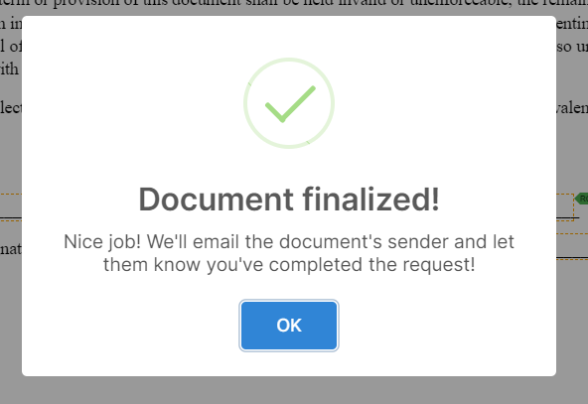
DocHub – Finalizing Form
*Note: Pay attention to what the form is asking you.
Notes:
DocHub - online software to sign documents
You will be able to tell how much more of the document need to be filled out.
The top photo shows the progression bar and how much left of the document needs to be completed.
The second photo shows when the progression bar is completed. From there, look on the right side and see the “Finalize” button. Click on that to complete, save, and send the document.
The third photo shows the “Are you sure you are ready”. Please note that once you send, you will not be able to edit the document further. Click on the “Finalize Document” green button once you are ready.
The fourth photo confirms that you saved the document and sent it off to me. The document will then automatically send to me.
***Please note: if you believe you forgot a piece, missed something, or have questions – please email me at rcalder@mwcc.mass.edu.

Slide 13
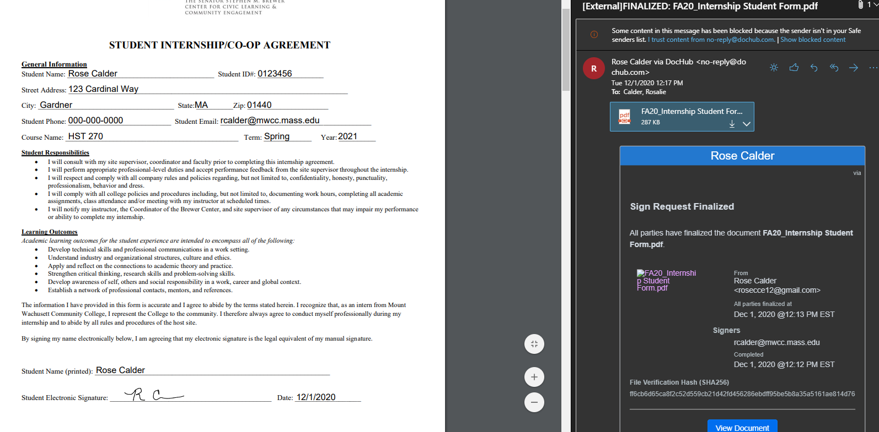
DocHub – Finalized Copy
Notes:
DocHub - online software to sign documents
Once you have completed the form, finalized it, and sent it back – you will receive an email from DocHub with the PDF copy of the form you filled out. This is a copy for you to keep.

Slide 14
Questions?
What questions, comments, or concerns do you have?

Slide 15
Give Pulse Guide
Rose Calder, M. Ed
MWCC Give Pulse Coordinator

Slide 16
Agenda
Claiming an Account
Navigating the Basics
Logging Hours

Slide 17
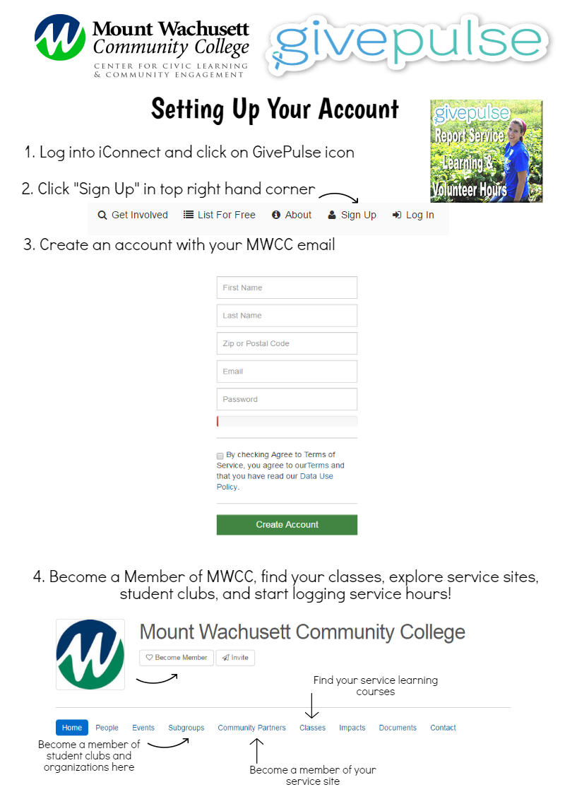
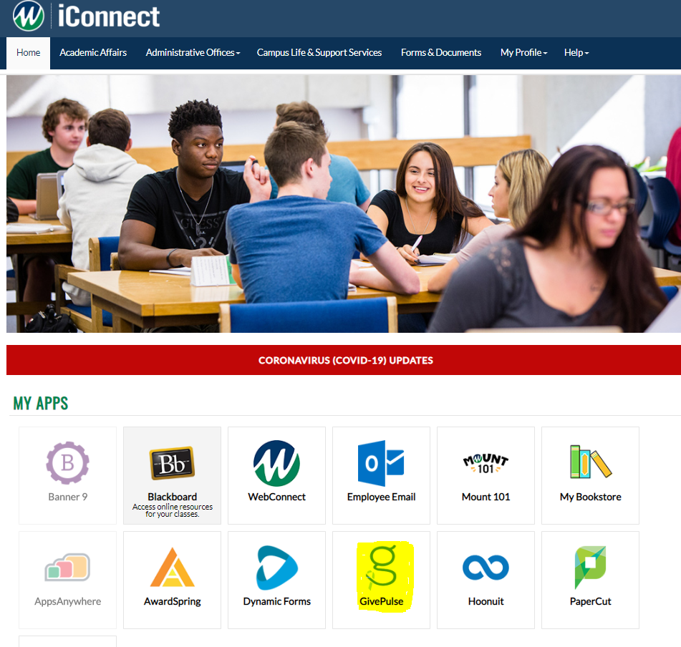
Claiming an Account
https://mwcc.givepulse.com/group/7845-Mount-Wachusett-Community-College
Notes:
Claiming a Give Pulse Account
Book mark the page – link
Log on through iConnect – highlighted what the GP icon looks like
Go through the steps to claim your account – must use an MWCC email

Slide 18
Navigating the Basics – Home Page
Notes:
Navigating the basics of Give Pulse…
**Please note - Impacts = Hours - Impacts are just Give Pulse’s fancy word for hours.
Home Page
This is the Home page of MWCC Give Pulse page. Being on this page indicates you are on the home screen.
Purple arrow is pointing to our MWCC icon. This will appear on every page and you can click on this icon to be brought back to the home screen always.
Yellow arrow indicates the navigation bar which will be on the top of every page. Utilize this to go across site pages.
You can change the language GP is in, find ways you can get involved, check on your own impacts, look at your own profile, and check messages.
4. Orange arrow indicates our tabs available to search. Find people, events, student groups, community partners, classes you are associated with, impacts
you make or need to verify, documents necessary to MWCC, as well as contacts.

Slide 19
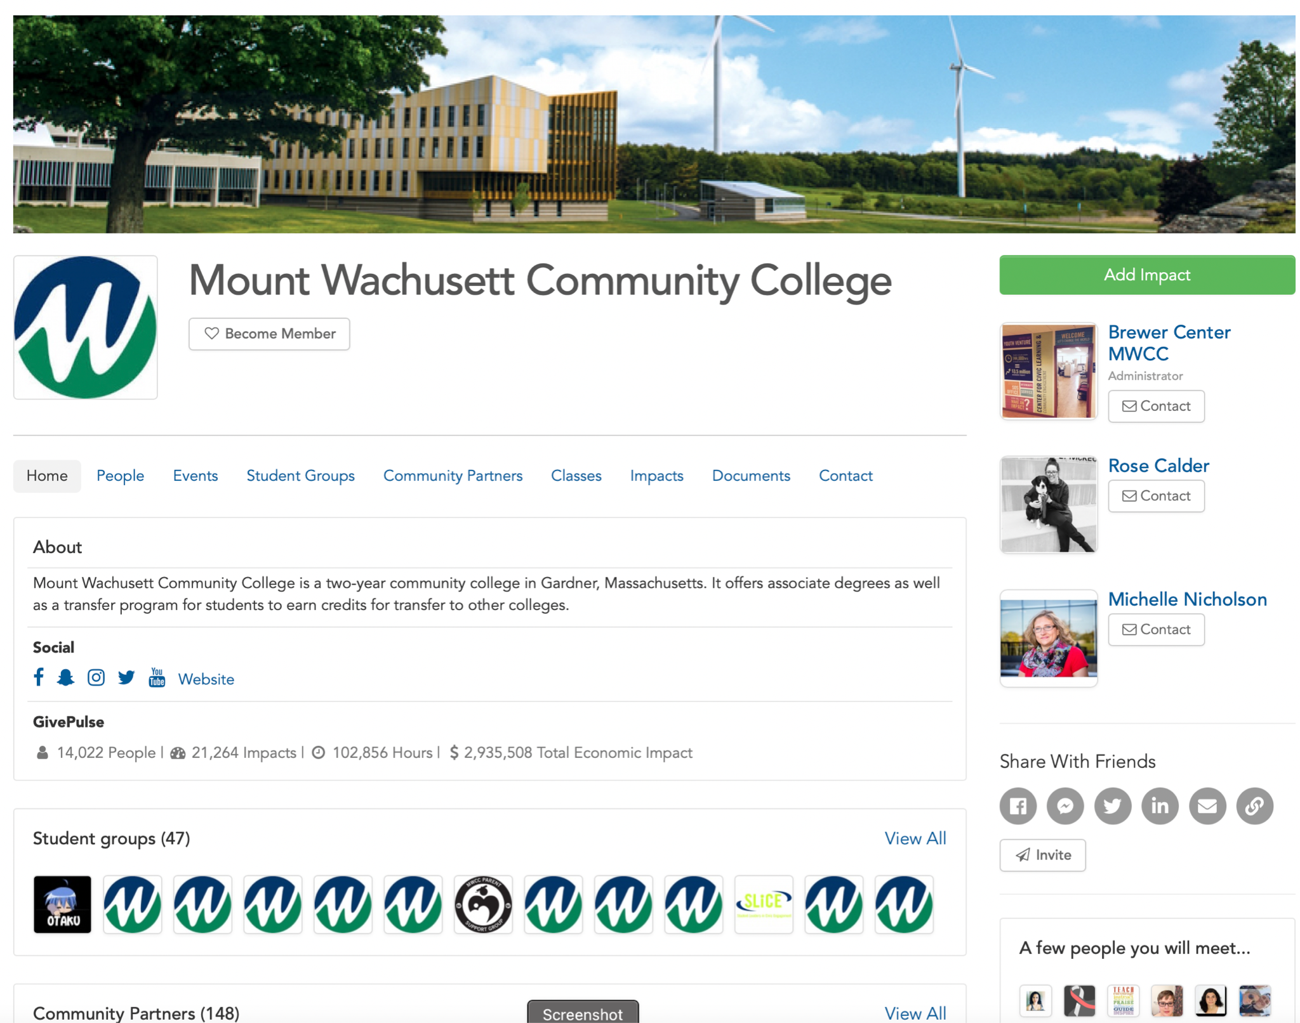
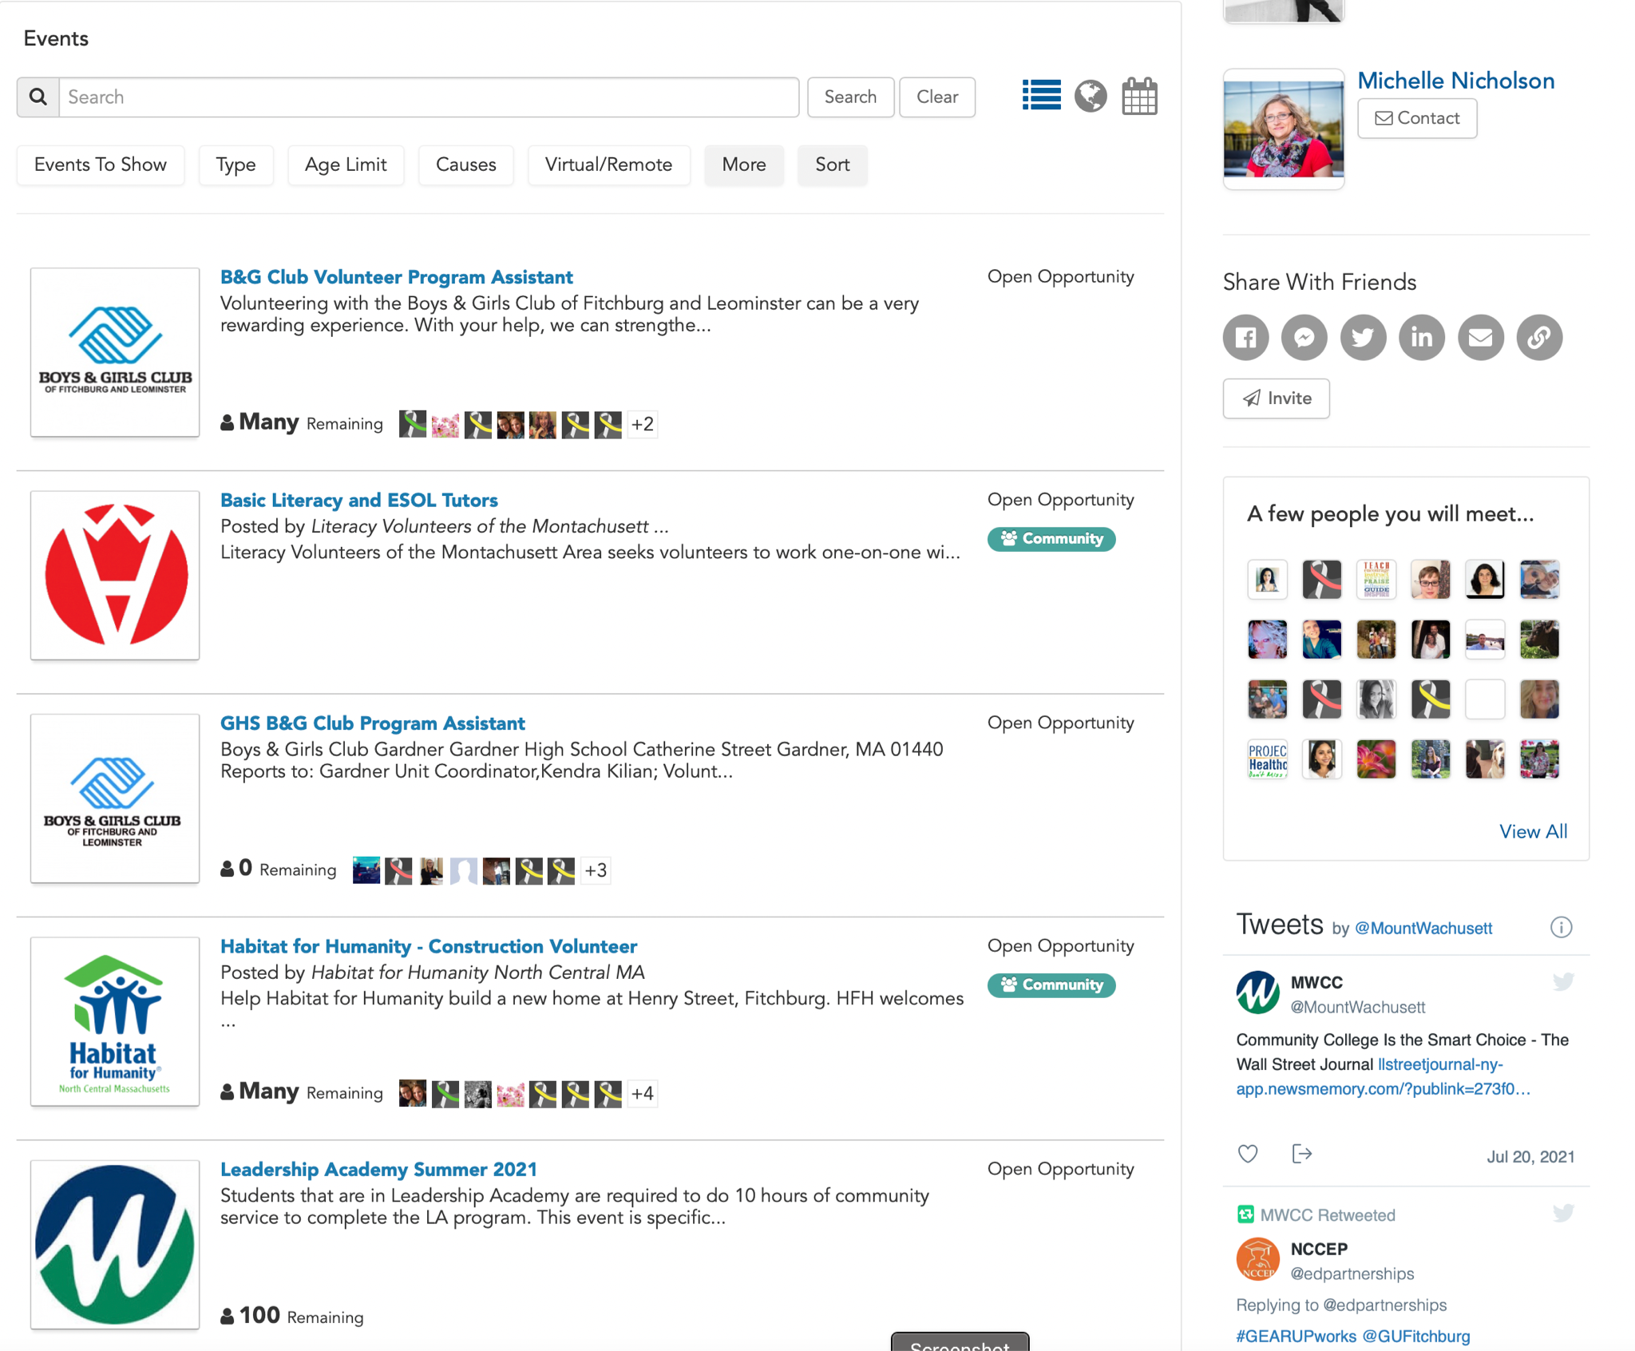
Navigating the Basics
Notes:
Navigating the basics…
On the main page of Give Pulse, look to the second navigation bar below.
Click on Events and all the list of events will appear
Find Leadership Academy Summer 2021 and click on the event

Slide 20
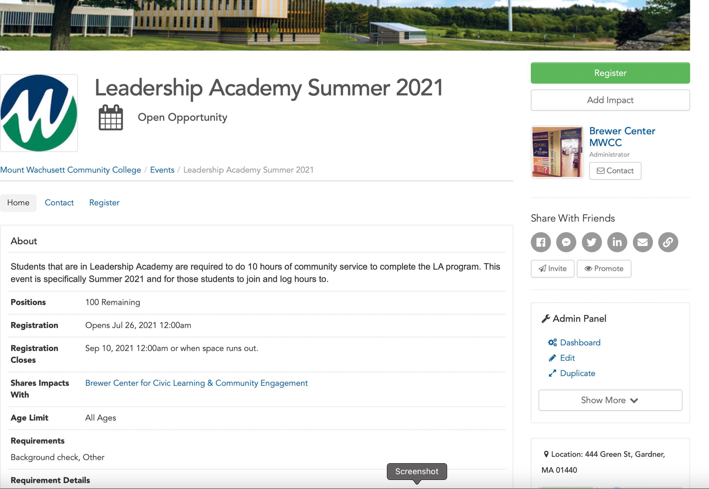
Navigating the Basics
Notes:
Navigating the basics…
Once on the event page, navigate to the top right corner and click on the green register button.

Slide 21
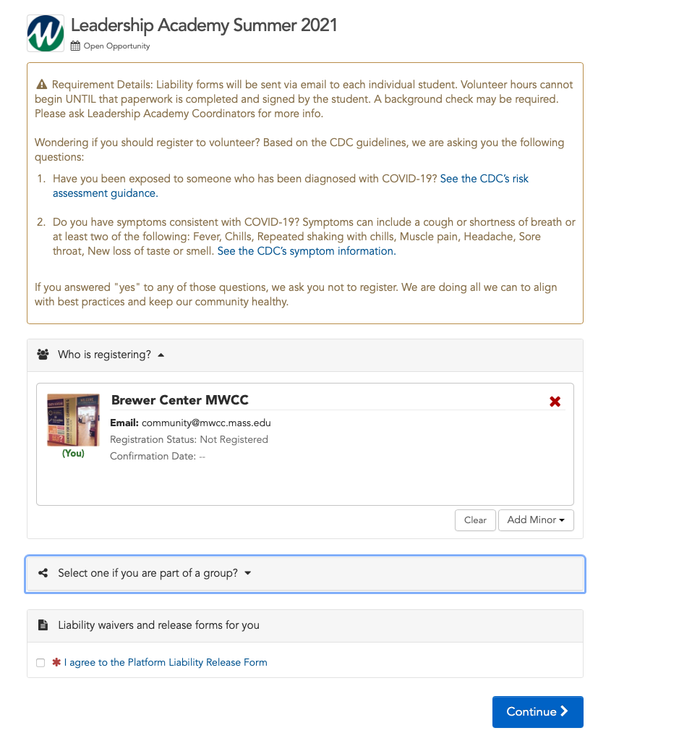
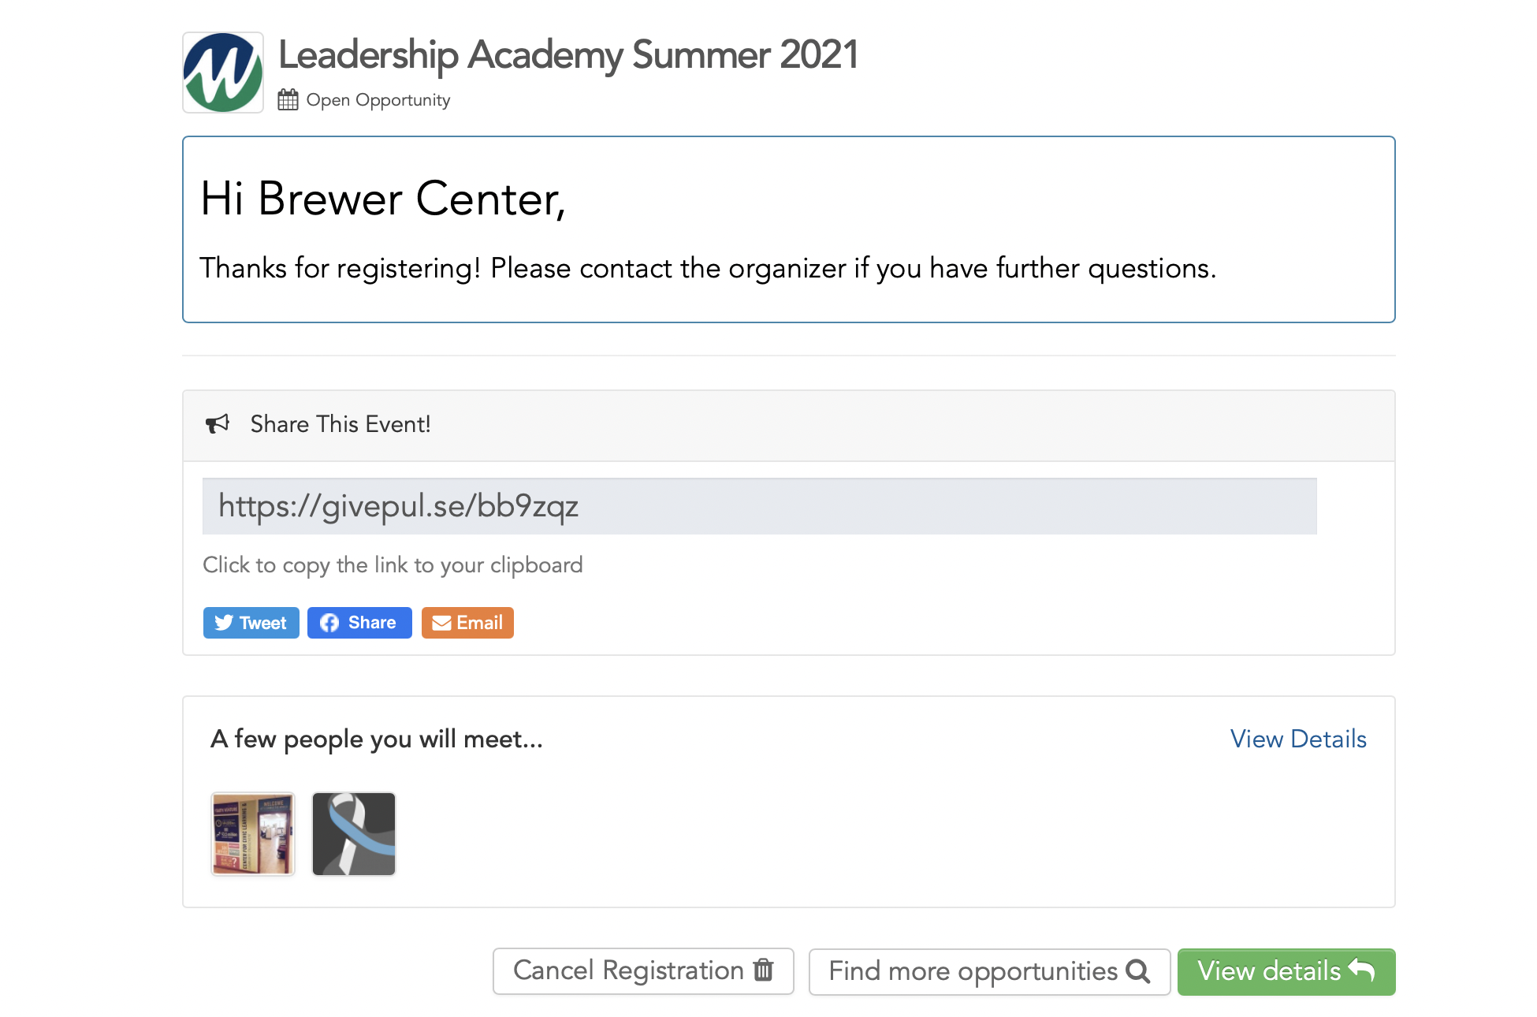
Navigating the Basics
Notes:
Navigating the basics…
After clicking on the green register button to register for the event, read the top box carefully.
Then check to see that you are registering with your name and MWCC email.
Next box you can ignore about being a part of a group
Last box is the Give Pulse liability form and release from the platform, this is different from the liability form I will be sending via Doc Hub.
Please read and review and click “I agree” to continue
Then click “Continue” blue button to complete the registration
After registering, a new box will appear to say you have completed the registration.

Slide 22
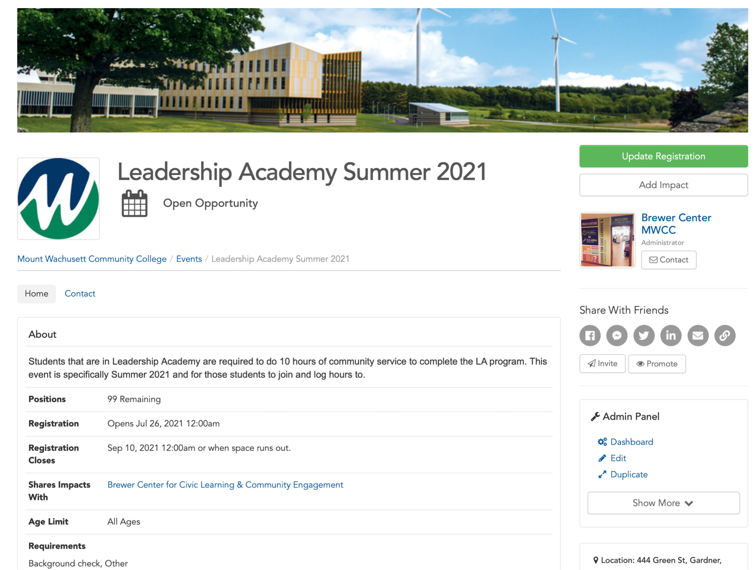
Logging Hours - Impact
Notes:
Note: You can always click on the MWCC icon in the top left to get back to the home page (indicated with the purple square in the photo above)
Logging Hours…
Back on the main event page, this area is where you will log hours.
In the top right corner after you have registered, you will be given the option to “Add Impacts” - please note that impact means hours
When you are ready to log your 10 hours that are completed, you will click on the “Add Impact” button on this event page to assure that it will be logged to the event.
PLEASE be sure to hand write or keep a paper log as you are completing your hours so that when you log to GP, you can have that info.

Slide 23
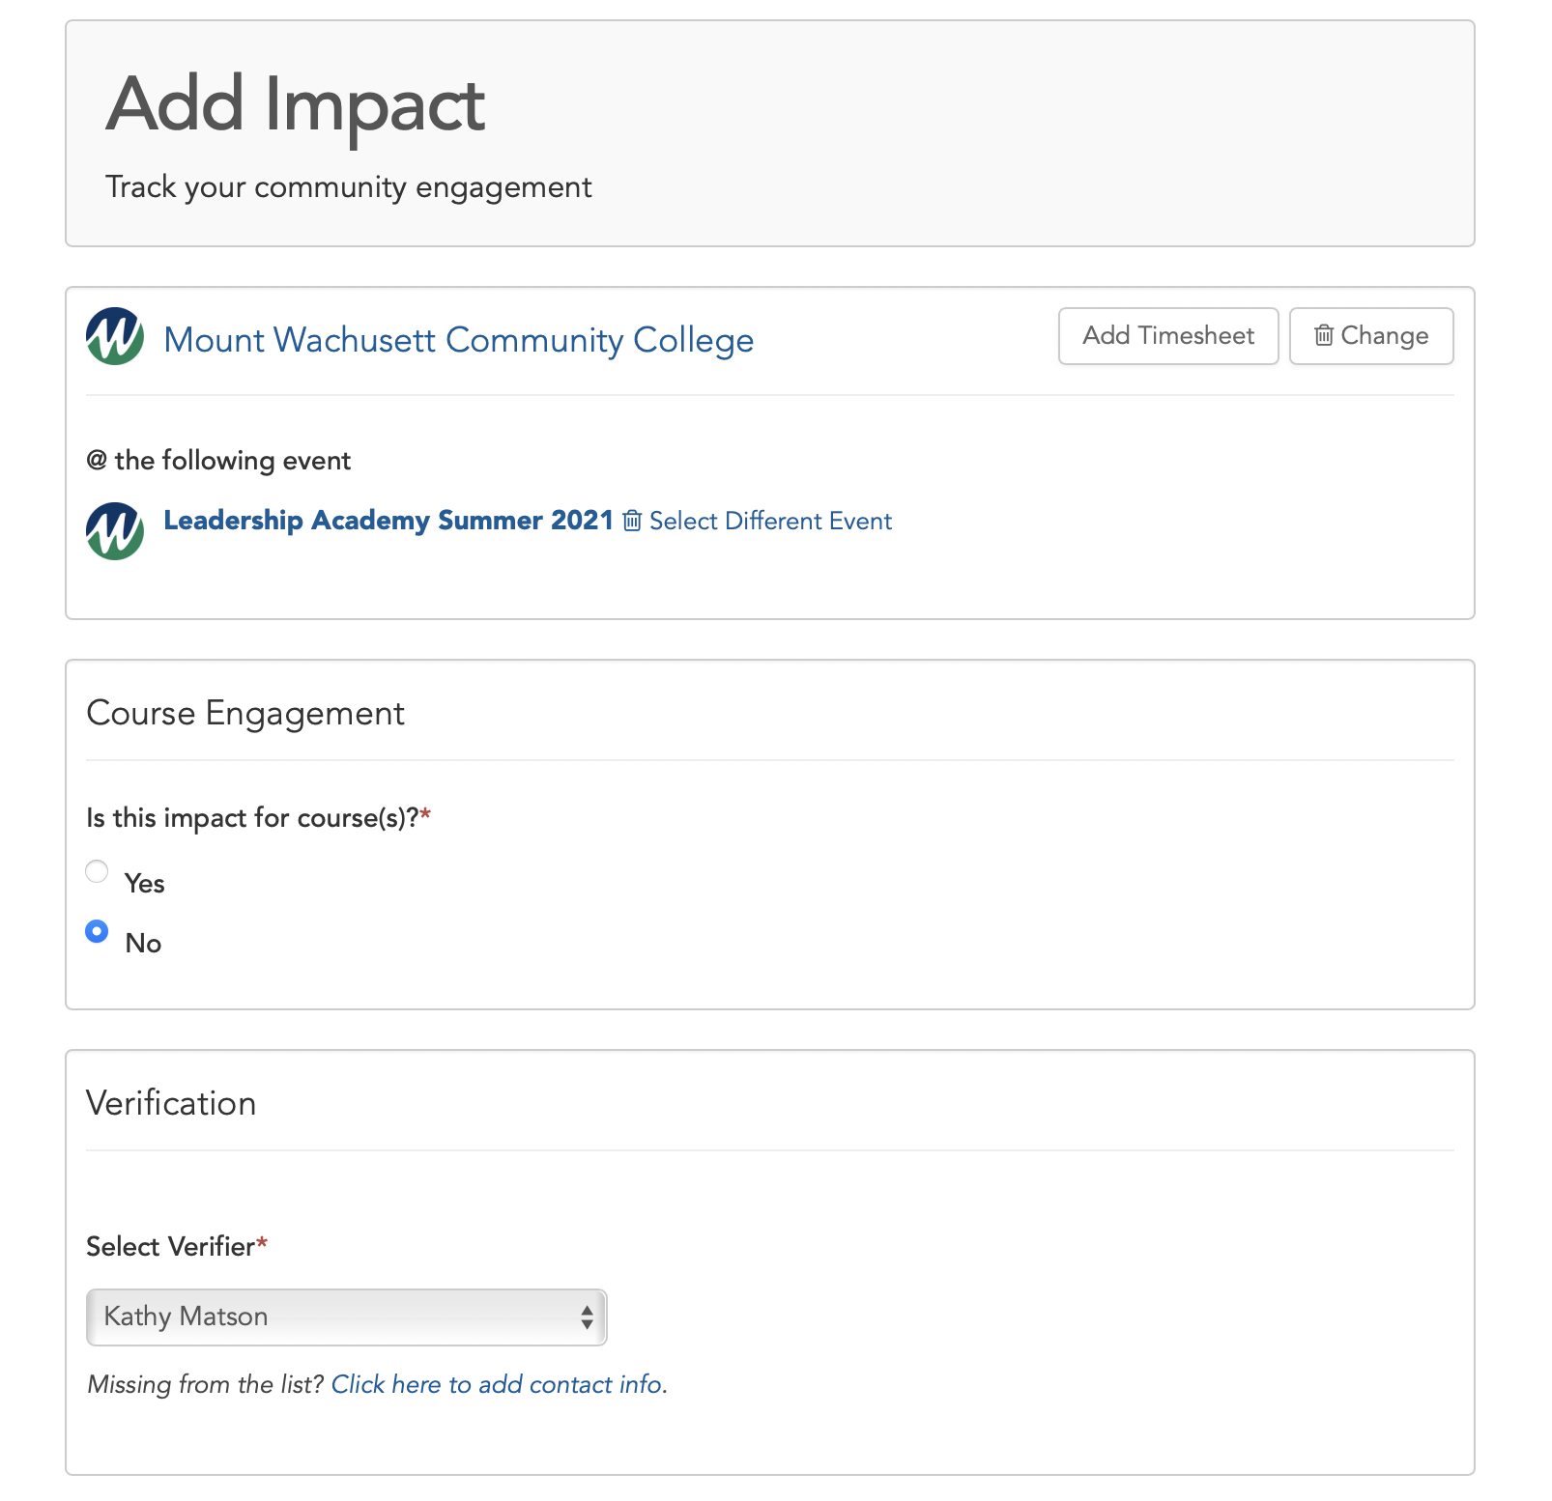
Logging Hours - Impact
Notes:
Note: You can always click on the MWCC icon in the top left to get back to the home page (indicated with the purple square in the photo above)
Once clicking the “Add Impact” button on the event page, this is the screen that will pop up.
You will notice you are logging to the correct event as the title will appear in the top box.
In that box, you will click on “Add Timesheet” to be able to add multiple days/hours in one log.
Next for course engagement, you can select “No” because it is not attached to a course.
For verification, please use the drop down menu to select “Kathy Matson” as the verifier.
Selecting Kathy means that she is notified to check your hours to say yes you did them and give you credit

Slide 24
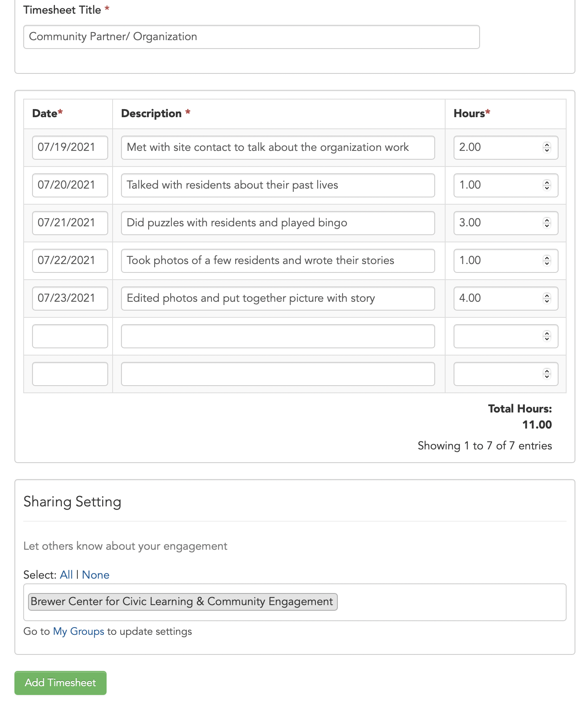
Logging Hours/Impacts
Notes:
Note: You can always click on the MWCC icon in the top left to get back to the home page (indicated with the purple square in the photo above)
Logging Hours…
Part 2 of logging hours…
For the “Timesheet Title” box, please put who the organization or community partner is.
Next section is the log. Please see the example to understand how the log should be filled out. Detail is extremely important so your verifier can review and easily approve.
Note at the bottom of that logging section will tally up the total number of hours.
Each line in the log should be a day. So please tally up the total hours you did per that day whether consecutive or not, and add as one line per day.
Once down logging all the day/times, you can ignore the sharing setting section.
Please click on the green “Add Timesheet” button to complete logging your hours.

Slide 25
Next Steps – Check List
1.Create Give Pulse Account
Register for Leadership Academy 2021 Event
2. Brainstorm what service project you would like to do
Email Rose at rcalder@mwcc.mass.edu with any questions/concerns/or site idea.
3. Receive DocHub email to fill out Liability Form
Follow the instructions that DocHub lays out
4. Inform Rose/Kathy of your project idea.
Notes:
Next Steps…
Please refer to the email sent with this PPT on next steps for your LA requirements.

Slide 26
Rose Calder
Civic Engagement Coordinator,
Senator Stephen M. Brewer Center for Civic Learning and Community Engagement
rcalder@mwcc.mass.edu
Notes:
Still have questions or concerns? Or problems are arising with Give Pulse? Contact me yourself or have you student in need reach out.
Contact Rose Calder - Civic Engagement Coordinator,
Senator Stephen M. Brewer Center for Civic Learning and Community Engagement
rcalder@mwcc.mass.edu

